Slide 1
Unit - 4
Training Techniques

Slide 2
Stochastic gradient descent (SGD):
Refer this link:
https://www.geeksforgeeks.org/ml-stochastic-gradient-descent-sgd/
Points to be refered:
Gradient Descent in Brief
Types of Gradient Descent:
Stochastic Gradient Descent (SGD):
Advantages:
Disadvantages:

Slide 3
AdaGrad:
A limitation of gradient descent is that it uses the same step size (learning rate) for each input variable. This can be a problem on objective functions that have different amounts of curvature in different dimensions, and in turn, may require a different sized step to a new point.
Adaptive Gradients, or AdaGrad for short, is an extension of the gradient descent optimization algorithm that allows the step size in each dimension used by the optimization algorithm to be automatically adapted based on the gradients seen for the variable (partial derivatives)

Slide 4
Continued
Refer this link:
https://www.geeksforgeeks.org/intuition-behind-adagrad-optimizer/
Points to be refered:
Intuition behind Adagrad Optimizer
Advantages of Adagrad:
disadvantage

Slide 5
Adam:
Refer this link:
https://www.geeksforgeeks.org/intuition-of-adam-optimizer/
Points to be refered:
Adam Optimizer
How Adam works?
Momentum:
Root Mean Square Propagation (RMSP):
Mathematical Aspect of Adam Optimizer
Performance:

Slide 6
Initial Weight Values:
Zero initialization
Random initialization

Slide 7
Regularization:
Regularization, in the context of neural networks, is a process of preventing a learning model from getting overfitted over training data. It involves a mechanism to reduce generalization errors of the learning model.
Regularization is a technique which makes slight modifications to the learning algorithm such that the model generalizes better

Slide 8
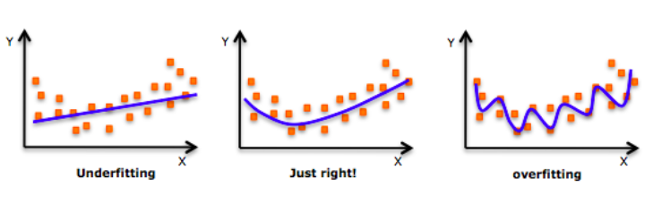
Overfitting and underfitting are the most common problems that programmers face while working with deep learning models

Slide 9
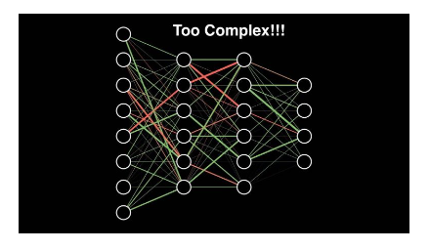

Slide 10
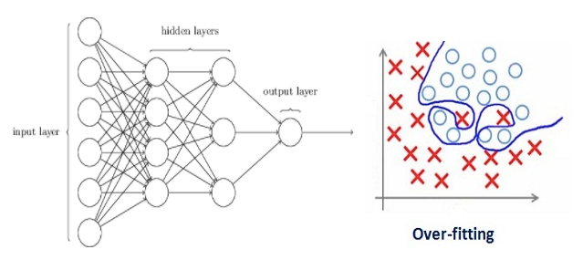
Over fitted network

Slide 11
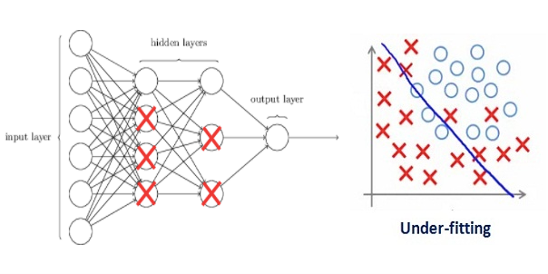
Regularization helps to reduce Overfitting
Regularization penalizes the coefficients
Such a large value of the regularization coefficient is not useful

Slide 12
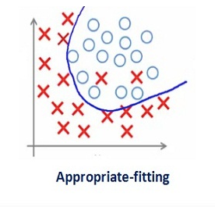
We need to optimize the value of regularization coefficient in order to obtain a well-fitted model

Slide 13
Different Regularization Techniques in Deep Learning
L2 & L1 regularization
Dropout

Slide 14
L2 & L1 regularization
Cost function = Loss + Regularization

Slide 15

L2: (Weight Decay)

Slide 16

L1

Slide 17
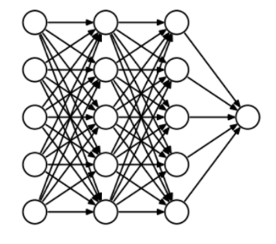
Dropout

Slide 18
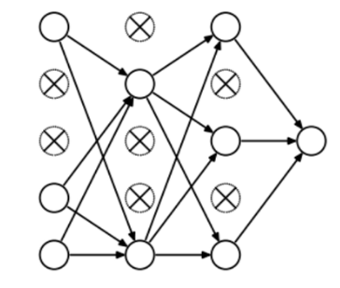

Slide 19
Cross-Validation and Hyperparameter Tuning:
Purpose of Cross Validation:
The purpose of cross validation is to assess how your prediction model performs with an unknown dataset.

Slide 20
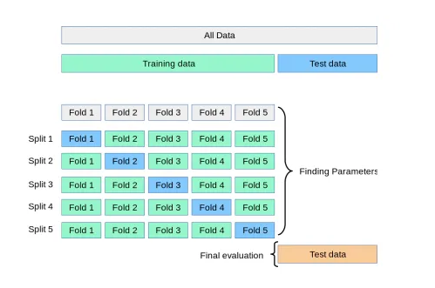
K-fold Cross-Validation:

Slide 21
Hyperparameter Tuning:
Hyperparameters are parameters that can be set by the user before training a Machine Learning model.
Examples of hyperparameters are
the number of decision trees to have,
the maximum number of features to consider at each split or
the maximum depth of the tree

Slide 22
Thank you

